Slide 1
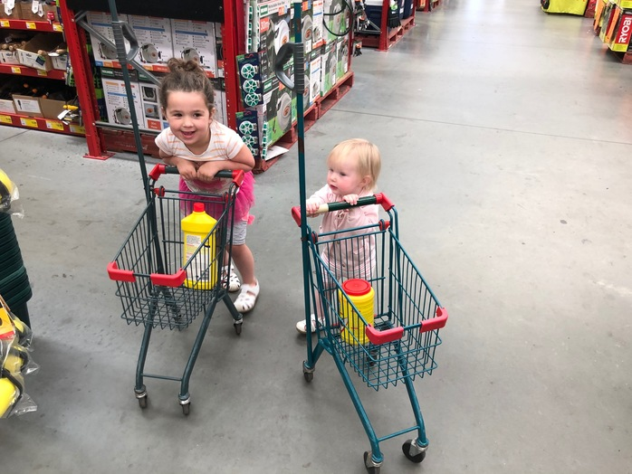
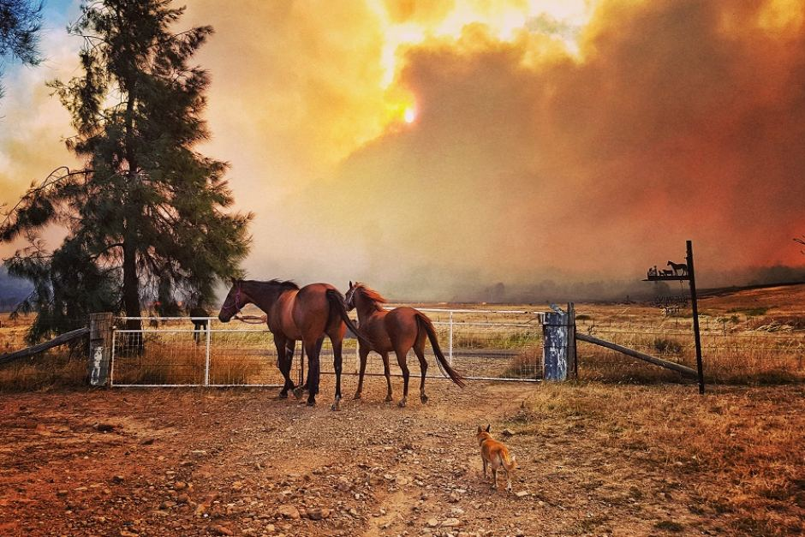
Conversation Class
Christopher bAUMAN

Slide 2
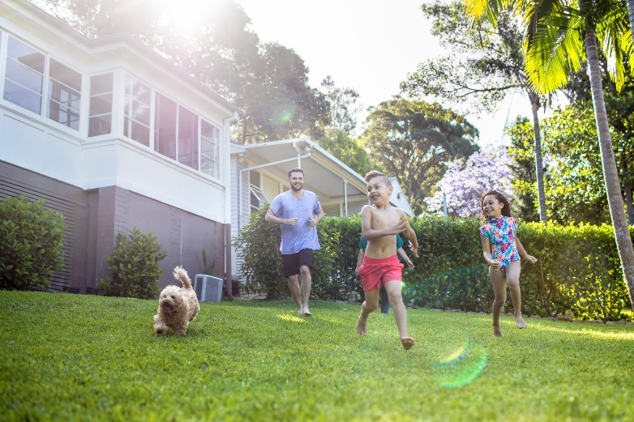
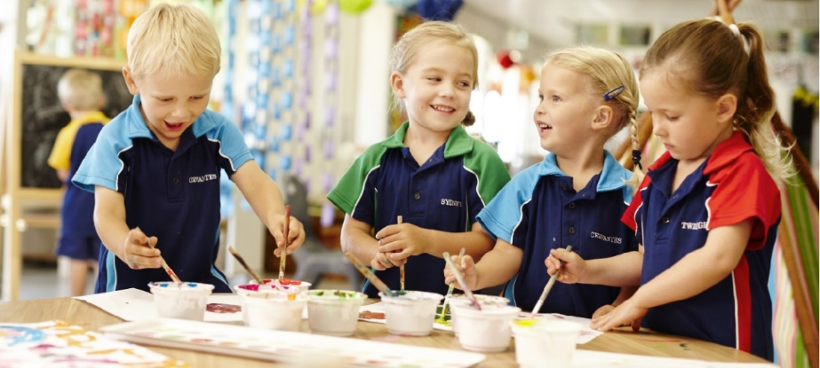
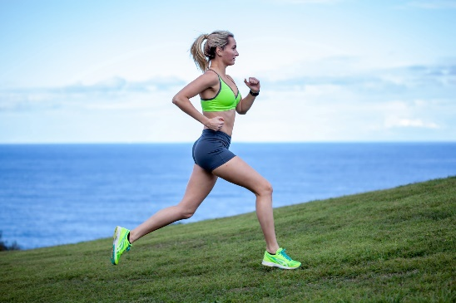
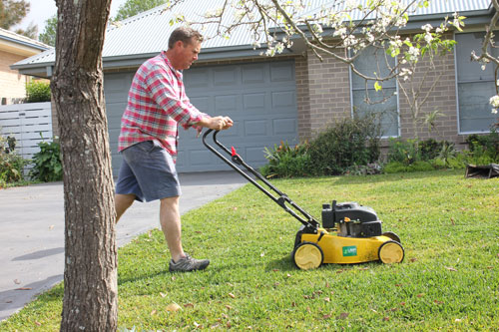
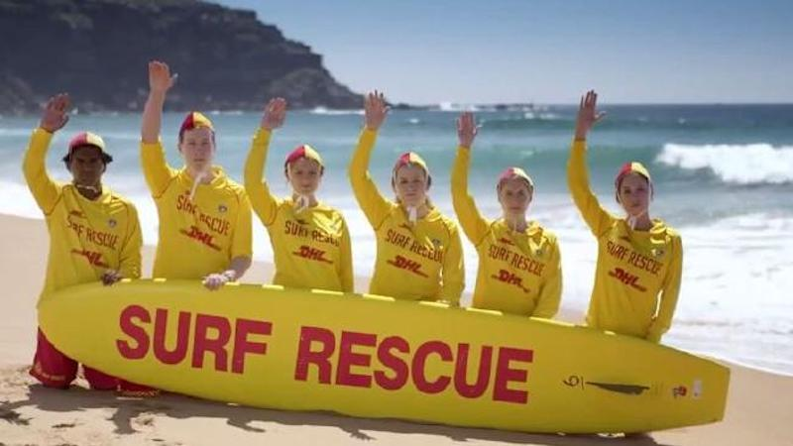
Education Infographic
Australia
Beach Safety
Choose a city – Student life?
Christmas / Easter
Holidays
Discrimination
Judgmental glare
Seed of insecurity has been planted
Have credibility measured
A floor in logic
Reconciliation
Teachers
Education
Skills
Chris Bauman

Slide 3
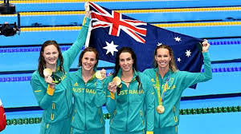
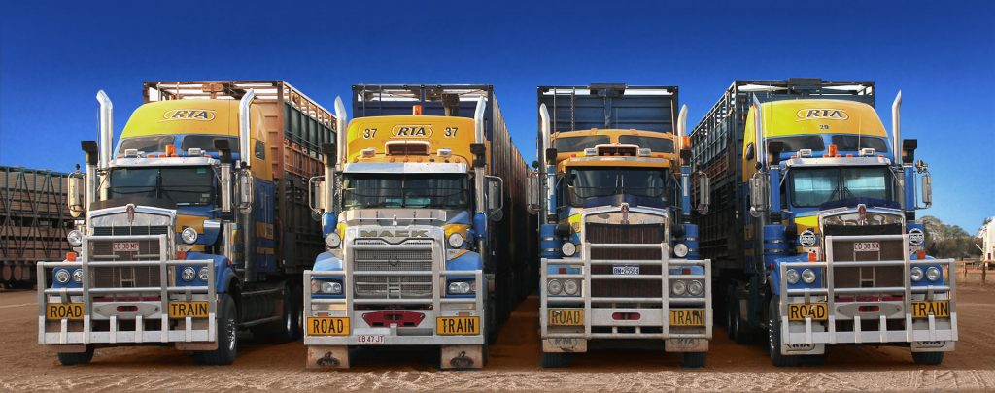
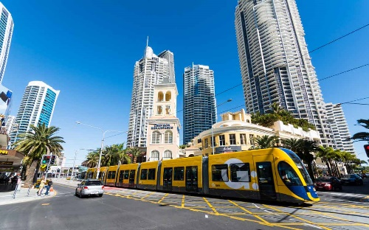
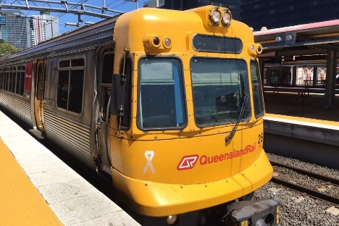
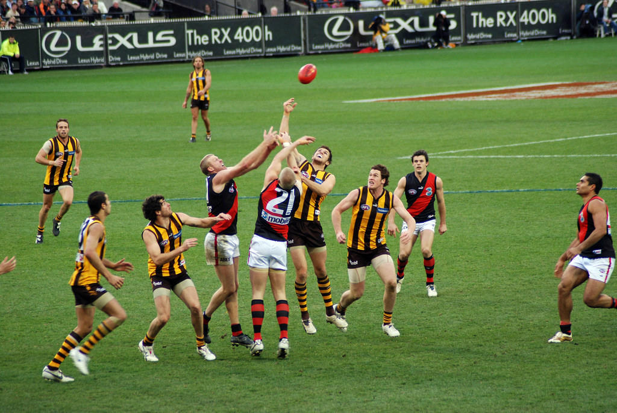
Slang
Look up some slang and test your friend….
A Cold One –
Ankle Biter –
Arvo –
Bail –
Barbie –
Beauty! –
Bloody –
Bloody oath –
Booze Bus –
Flat out –
Footy –
Frothy –
G’day
Galah –
Gnarly –
Going off –
Good On Ya –
Hard yakka –
Heaps –
Hoon –
Iffy –
Knickers
Shout –

